Slide 1
Week 2- Historical encryption algorithms
and
Stream Ciphers

Slide 2
Historical encryption algorithms

Slide 3
Ceasar cipher: Example of a Substitution Cipher
The Caesar cipher is a simple example of a substitution cipher, specifically a monoalphabetic substitution cipher. It operates on individual letters or characters in a message, shifting them by a fixed number of positions in the alphabet to create the ciphertext.

Slide 4
Ceasar cipher
a b c d e f g h i j k l m n o p q r s t u v w x y z
a b c d e f g h i j k l m n o p q r s t u v w x y z
…
a
in the far distance a helicopter skimmed down between the roofs, hovered for an instant like a bluebottle, and darted away again with a curving flight. It was the police patrol, snooping into people's windows
lq wkh idu glvwdqfh d kholfrswhu vnlpphg grzq ehwzhhq wkh urriv, kryhuhg iru dq lqvwdqw olnh d eoxherwwoh, dqg gduwhg dzdb djdlq zlwk d fxuylqj ioljkw. Lw zdv wkh srolfh sdwuro, vqrrslqj lqwr shrsoh'v zlqgrzv

Slide 5
Ceasar cipher (ROT-13)
a b c d e f g h i j k l m n o p q r s t u v w x y z
a b c d e f g h i j k l m n o p q r s t u v w x y z
in the far distance a helicopter skimmed down between the roofs, hovered for an instant like a bluebottle, and darted away again with a curving flight. It was the police patrol, snooping into people's windows
va gur sne qvfgnapr n uryvpbcgre fxvzzrq qbja orgjrra gur ebbsf,
ubirerq sbe na vafgnag yvxr n oyhrobggyr, naq qnegrq njnl ntnva jvgu n pheivat syvtug. Vg jnf gur cbyvpr cngeby, fabbcvat vagb crbcyr'f jvaqbjf

Slide 6

Ceasar cipher
a ↔ 0
b ↔ 1
c ↔ 2
d ↔ 3
e ↔ 4
⁞
z ↔ 25
$$C←M+3 (\operatorname{mod}{26})$$

Slide 7







ROT-13
a ↔ 0
b ↔ 1
c ↔ 2
d ↔ 3
e ↔ 4
⁞
z ↔ 25
$$C←M+13 (\operatorname{mod}{26})$$
$$M←C−13 (\operatorname{mod}{26})$$
$$𝒦=\{ \}$$
$$ℰ :𝒦×ℳ→𝒞$$
$$ℳ=\{0,1,2,…, 25\}$$
$$𝒟 :𝒦×𝒞→ℳ$$
$$𝒞=\{0,1,2,…, 25\}$$

Slide 8


ROT-K
a ↔ 0
b ↔ 1
c ↔ 2
d ↔ 3
e ↔ 4
⁞
z ↔ 25
$$C←M+K (\operatorname{mod}{26})$$
$$𝒦=\{0,1,2,…, 25\}$$
$$ℰ :𝒦×ℳ→𝒞$$
$$ℳ=\{0,1,2,…, 25\}$$
$$𝒟 :𝒦×𝒞→ℳ$$
$$𝒞=\{0,1,2,…, 25\}$$

Slide 9
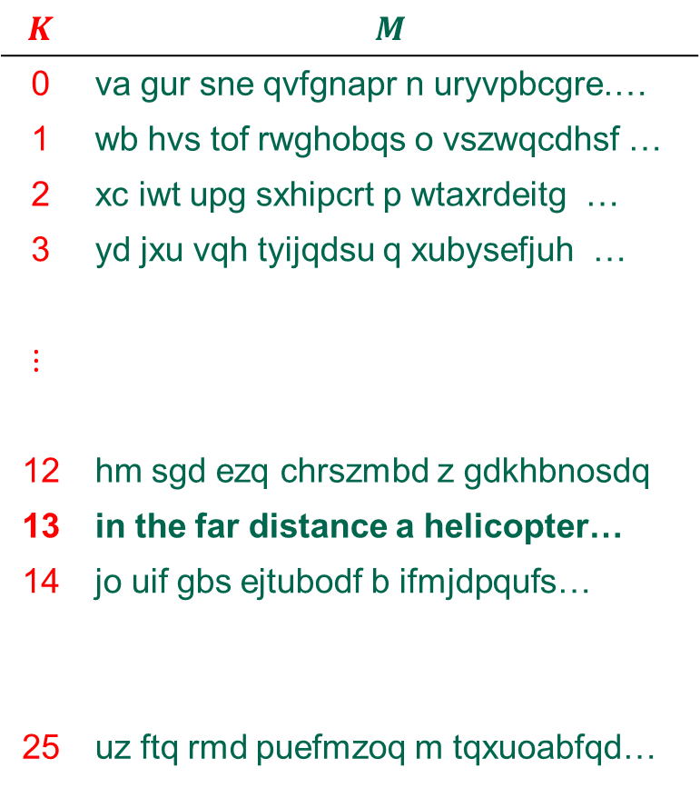
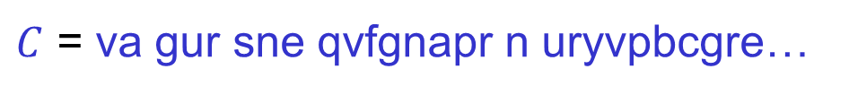

Attacking ROT-K
$$K$$ | $$M$$
0 | va gur sne qvfgnapr n uryvpbcgre.…
1 | wb hvs tof rwghobqs o vszwqcdhsf …
2 | xc iwt upg sxhipcrt p wtaxrdeitg …
3 | yd jxu vqh tyijqdsu q xubysefjuh …
$$⋮$$
12 | hm sgd ezq chrszmbd z gdkhbnosdq
13 | in the far distance a helicopter…
14 | jo uif gbs ejtubodf b ifmjdpqufs…
25 | uz ftq rmd puefmzoq m tqxuoabfqd…
$$\left|𝒦\right|=26$$
$C$ = va gur sne qvfgnapr n uryvpbcgre…

Slide 10



Substitution cipher
a b c d e f g h i j k l m n o p q r s t u v w x y z
↕ ↕ ↕ ↕ … ↕
s x d y w q f m j k o i l g z b e n t u c p a r v h
$\left|𝒦\right|=$
$$26!$$
$$≈{10}^{26}≈2^{88}$$
in the far distance a helicopter skimmed down between the roofs, hovered for an instant like a bluebottle, and darted away again with a curving flight. It was the police patrol, snooping into people's windows
jg umw qsn yjtusgdw s mwijdzbuwn tojllwy yzag xwuawwg umw nzzqt, mzpwnwy qzn sg jgtusgu ijow s xicwxzuuiw, sgy ysnuwy sasv sfsjg ajum s dcnpjgf qijfmu. ju ast umw bzijdw bsunzi, tgzzbjgf jguz bwzbiw't ajgyzat

Slide 11



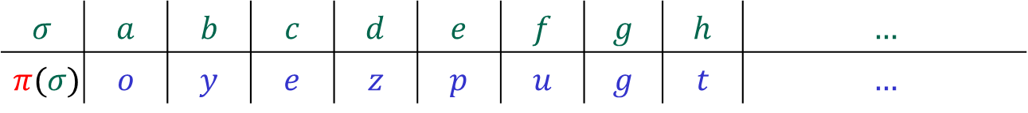

Substitution cipher – formal syntax
$Σ=\{a,b,c,…, z\}$
$ℳ=Σ^{∗}$
$𝒞=Σ^{∗}$
$𝒦=all permutations on Σ$
$π∈𝒦$
$M=feed$
$C= ℰ\left(π, M\right)=π\left(f\right)π\left(e\right)π\left(e\right)π\left(d\right)=uppz$
$𝒟\left(π, C\right)=π^{−1}\left(u\right)π^{−1}\left(p\right)π^{−1}\left(p\right)π^{−1}\left(z\right)=feed$
$$ℰ :𝒦×ℳ→𝒞$$
$$𝒟 :𝒦×𝒞→ℳ$$
$$=\{π :Σ→Σ ∣π a permutation\}$$
$$σ$$ | $$a$$ | $$b$$ | $$c$$ | $$d$$ | $$e$$ | $$f$$ | $$g$$ | $$h$$ | $$…$$
$$π(σ)$$ | $$o$$ | $$y$$ | $$e$$ | $$z$$ | $$p$$ | $$u$$ | $$g$$ | $$t$$ | $$…$$

Slide 12
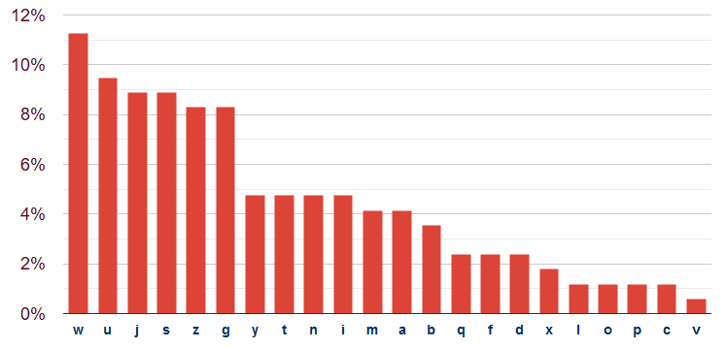
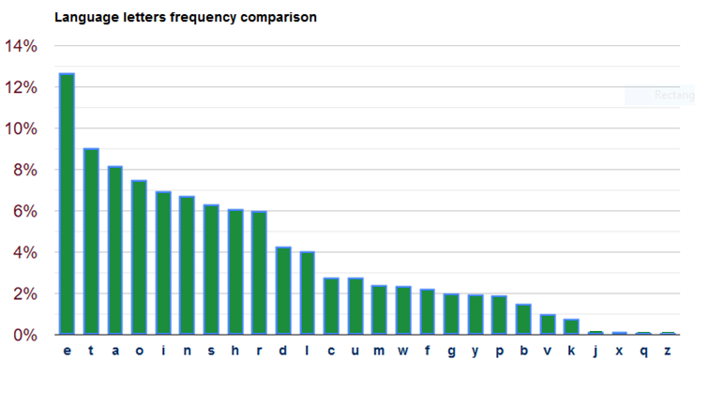



Attacking the substitution cipher
$\left|𝒦\right|=$
jg umw qsn yjtusgdw s mwijdzbuwn tojllwy yzag xwuawwg umw nzzqt, mzpwnwy qzn sg jgtusgu ijow s xicwxzuuiw, sgy ysnuwy sasv sfsjg ajum s dcnpjgf qijfmu. ju ast umw bzijdw bsunzi, tgzzbjgf jguz bwzbiw't ajgyzat
$$26!$$
$$≈{10}^{26}≈2^{88}$$

Slide 13
Attacking the substitution cipher
$\left|𝒦\right|=$
jg ume qsn yjtusgde s meijdzbuen tojlley yzag xeuaeeg ume nzzqt, mzpeney qzn sg jgtusgu ijoe s xicexzuuie, sgy ysnuey sasv sfsjg ajum s dcnpjgf qijfmu. ju ast ume bzijde bsunzi, tgzzbjgf jguz bezbie't ajgyzat
$$26!$$
$$≈{10}^{26}≈2^{88}$$
✗
✓

Slide 14
Attacking the substitution cipher
$\left|𝒦\right|=$
jg tme qsn yjttsgde s meijdzbten tojlley yzag xetaeeg tme nzzqt, mzpeney qzn sg jgttsgt ijoe s xicexzttie, sgy ysntey sasv sfsjg ajtm s dcnpjgf qijfmt. jt ast tme bzijde bstnzi, tgzzbjgf jgtz bezbie't ajgyzat
$$26!$$
$$≈{10}^{26}≈2^{88}$$
✗
✗
✓
✓

Slide 15
Attacking the substitution cipher
$\left|𝒦\right|=$
jg tme qan yjttagde a meijdzbten tojlley yzag xetaeeg tme nzzqt, mzpeney qzn ag jgttagt ijoe a xicexzttie, agy yantey aaav afajg ajtm a dcnpjgf qijfmt. jt aat tme bzijde batnzi, tgzzbjgf jgtz bezbie't ajgyzat
$$26!$$
$$≈{10}^{26}≈2^{88}$$
✗
✗
✗
✓
✓
✓

Slide 16
Attacking the substitution cipher
$\left|𝒦\right|=$
ig tme qan yittagde a meiidzbten toilley yzag xetaeeg tme nzzqt, mzpeney qzn ag igttagt iioe a xicexzttie, agy yantey aaav afaig aitm a dcnpigf qiifmt. it aat tme bziide batnzi, tgzzbigf igtz bezbie't aigyzat
$$26!$$
$$≈{10}^{26}≈2^{88}$$
✗
✗
✗
✗
✓
✓
✓
✓

Slide 17
Attacking the substitution cipher
$\left|𝒦\right|=$
ig tme qan yittagde a meiidobten toilley yoag xetaeeg tme nooqt, mopeney qon ag igttagt iioe a xicexottie, agy yantey aaav afaig aitm a dcnpigf qiifmt. it aat tme boiide batnoi, tgoobigf igto beobie't aigyoat
$$26!$$
$$≈{10}^{26}≈2^{88}$$
✗
✗
✗
✗
✗
✓
✓
✓
✓
✓

Slide 18
Attacking the substitution cipher
$\left|𝒦\right|=$
in tme qan yittande a meiidobten toilley yoan xetaeen tme nooqt, mopeney qon an inttant iioe a xicexottie, any yantey aaav afain aitm a dcnpinf qiifmt. it aat tme boiide batnoi, tnoobinf into beobie't ainyoat
$$26!$$
$$≈{10}^{26}≈2^{88}$$
✗
✗
✗
✗
✗
✗
✓
✓
✓
✓
✓
✓

Slide 19
Attacking the substitution cipher
$\left|𝒦\right|=$
in tme qan yistande a meiidobten soilley yoan xetaeen tme nooqs, mopeney qon an instant iioe a xicexottie, any yantey aaav afain aitm a dcnpinf qiifmt. it aas tme boiide batnoi, tnoobinf into beobie's ainyoas
$$26!$$
$$≈{10}^{26}≈2^{88}$$
✗
✗
✗
✗
✗
✗
✗
✓
✓
✓
✓
✓
✓
✓

Slide 20
Attacking the substitution cipher
$\left|𝒦\right|=$
in the qan distande a heiidobter soilled down xetween the rooqs, hopered qor an instant iioe a xicexottie, and danted awav afain with a dcrpinf qiifht. it was tme boiide batroi, tnoobinf into beobie's windows
$$26!$$
$$≈{10}^{26}≈2^{88}$$
✗
✗
✗
✗
✗
✗
✗
✗
✗
✗
✗
✓
✓
✓
✓
✓
✓
✓
✓
✓
✓
✓
Notes:
https://planetcalc.com/8047/

Slide 21
Conclusions
Key space must be large enough
Ciphertext should not reveal letter frequency of the message
Is this enough?

Slide 22
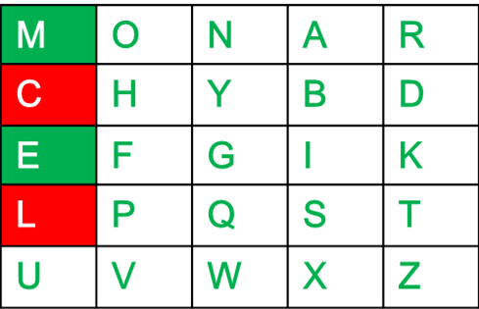
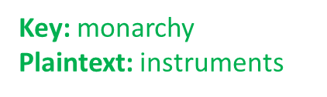
Playfair Cipher
The Playfair cipher was the first practical digraph substitution cipher. The
scheme was invented in 1854 by Charles Wheatstone but was named after Lord Playfair who promoted the use of the cipher.
In playfair cipher unlike traditional cipher we encrypt a pair of alphabets(digraphs) instead of a single alphabet.

Slide 23
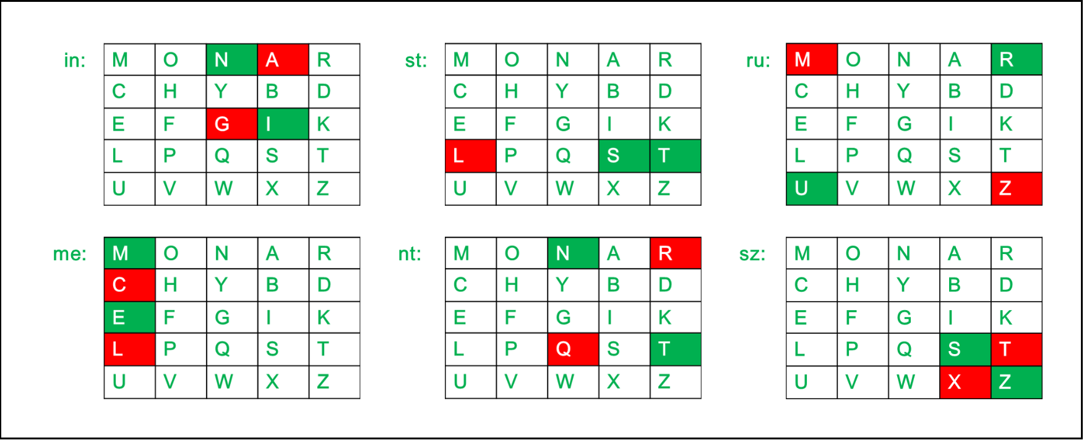
Playfair Cipher
Plain Text: "instrumentsz" Encrypted Text: gatlmzclrqtx

Slide 24
Cryptoanalysis of Playfair Cipher
Like most classical ciphers, the Playfair cipher can be easily cracked if there is enough text.
Obtaining the key is relatively straightforward if both plaintext and ciphertext are known.
When only the ciphertext is known, brute force cryptanalysis of the cipher involves searching through the key space for matches between the frequency of occurrence of digrams (pairs of letters) and and the known frequency of occurrence of digrams in the assumed language of the original message.

Slide 25



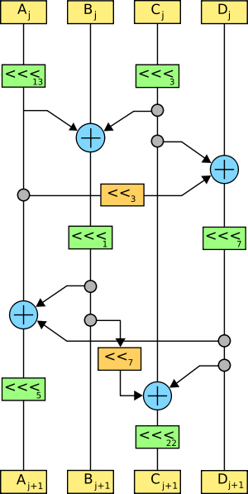
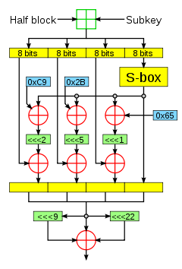
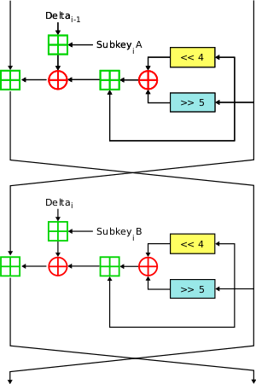
Historical approach to crypto development
build → break → fix → break → fix → break → fix ...

Slide 26
Modern approach
Trying to make cryptography more a science than an art
Focus on formal definitions of security (and insecurity)
Clearly stated assumptions
Analysis supported by mathematical proofs
... but old fashioned cryptanalysis continues to be very important!

Slide 27
Stream Ciphers

Slide 28
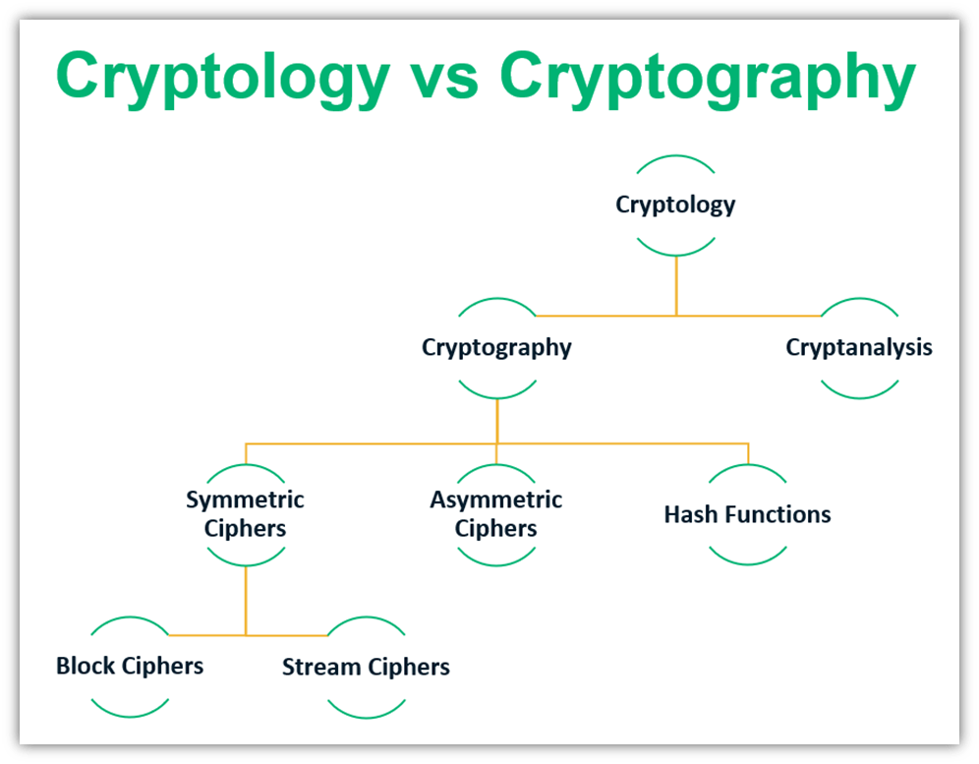

Stream Ciphers

Slide 29
Stream and Block Ciphers
Stream Ciphers and block ciphers are two categories of ciphers used in classical cryptography.
Stream and Block Ciphers differ in how large a piece of the message is processed in each encryption operation.
Stream ciphers encrypt plaintext one byte or one bit at a time.
Block ciphers encrypt plaintext in chunks. Common block sizes are 64 and 128 bits.

Slide 30



Stream Ciphers
Stream ciphers encrypt plaintext one byte or one bit at a time.
Key characteristics of stream ciphers include:
Pseudorandom Keystream: Stream ciphers generate a keystream, a sequence of pseudorandom bits or bytes. This keystream is combined with the plaintext using a bitwise operation (usually XOR) to produce the ciphertext. The same keystream generator and key are used at the sender and receiver to ensure that the decryption process is the reverse of encryption.
Synchronization: To decrypt the data correctly, the sender and receiver must be synchronized with the same initial state for the keystream generator. This is typically achieved by using the same secret key and an initialization vector (IV) at both ends.
Efficiency: Stream ciphers are designed to be computationally efficient and to have a low computational overhead. This makes them well-suited for encrypting data on the fly, especially in scenarios where high-speed encryption is required.
Security: The security of a stream cipher relies on the strength of the encryption algorithm and the secrecy of the key. If the key is kept secret and the keystream is unpredictable, stream ciphers can provide strong security.
One commonly used stream cipher is the "RC4" algorithm, which was widely used in applications like wireless networks and SSL/TLS encryption. However, it has known security vulnerabilities, and its use has decreased in favor of more secure stream ciphers.

Slide 31
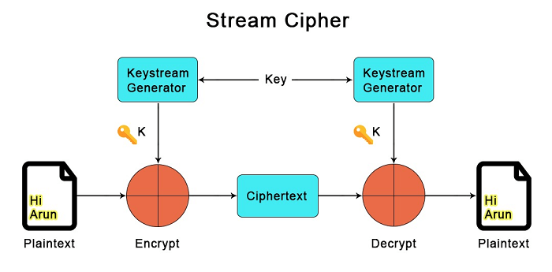
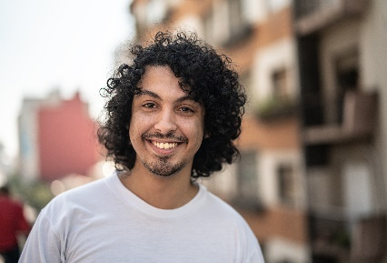

Stream Ciphers
Alice
Sender
Bob
Receiver
Source:https://www.javatpoint.com/block-cipher-vs-stream-cipher

Slide 32
The one-time-pad (OTP) = Vernam Cipher
Here's how the OTP works as a stream cipher:
Key Generation: A truly random and secret key that is at least as long as the plaintext is generated. This key is used only once, hence the name "one-time pad.”
Encryption: The key is combined with the plaintext using a bitwise XOR operation. This results in the creation of the ciphertext, which is as long as the plaintext.
Decryption: To decrypt the ciphertext, the exact same key is used in the same manner. XORing the key with the ciphertext reproduces the original plaintext.
The essential characteristics of the OTP as a stream cipher are:
It uses a keystream that is as long as the plaintext.
The key is random and remains secret.
Each key can be used only once, making it theoretically unbreakable if used correctly.

Slide 33















The one-time-pad (OTP)= Vernam Cipher
$𝒦 ={\left\{0,1\right\}}^{n}$
$$ℳ={\left\{0,1\right\}}^{n}$$
$$𝒞 ={\left\{0,1\right\}}^{n}$$
$$ℰ :𝒦×ℳ→𝒞$$
$$𝒟 :𝒦×𝒞→ℳ$$
$$ℰ\left(K, M\right)=K⊕M$$
$$𝒟\left(K, C\right)=K⊕C$$
$$0101100100$$
$$⊕1110001101 \\ −−−−−−−−− \\ = 1011101001$$
$$M$$
$$1011101001$$
$$⊕1110001101 \\ −−−−−−−−− \\ = 0101100100$$
$$C$$
$$K$$
$$K$$
$$C$$
$$M$$

Slide 34
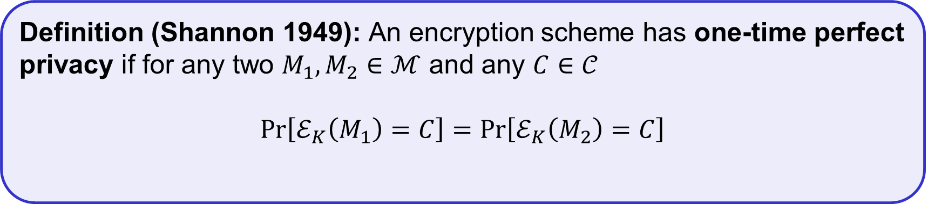
The one-time-pad (OTP)= Vernam Cipher
$𝒦 ={\left\{0,1\right\}}^{n}$
$$ℳ={\left\{0,1\right\}}^{n}$$
$$𝒞 ={\left\{0,1\right\}}^{n}$$
$$ℰ :𝒦×ℳ→𝒞$$
$$𝒟 :𝒦×𝒞→ℳ$$
$$ℰ\left(K, M\right)=K⊕M$$
$$𝒟\left(K, C\right)=K⊕C$$
Theorem: The OTP encryption scheme has one-time perfect privacy
Definition (Shannon 1949): An encryption scheme has one-time perfect privacy if for any two $M_{1}, M_{2}∈ℳ$ and any $C∈𝒞$
$$Pr\left[ℰ_{K}\left(M_{1}\right)=C\right]=Pr\left[ℰ_{K}\left(M_{2}\right)=C\right]$$
(probability taken over the random choice $K\underset{←}{\$}𝒦$ and the random coins used by $ℰ$ (if any))
Notes:
Why is this significant?

Slide 35
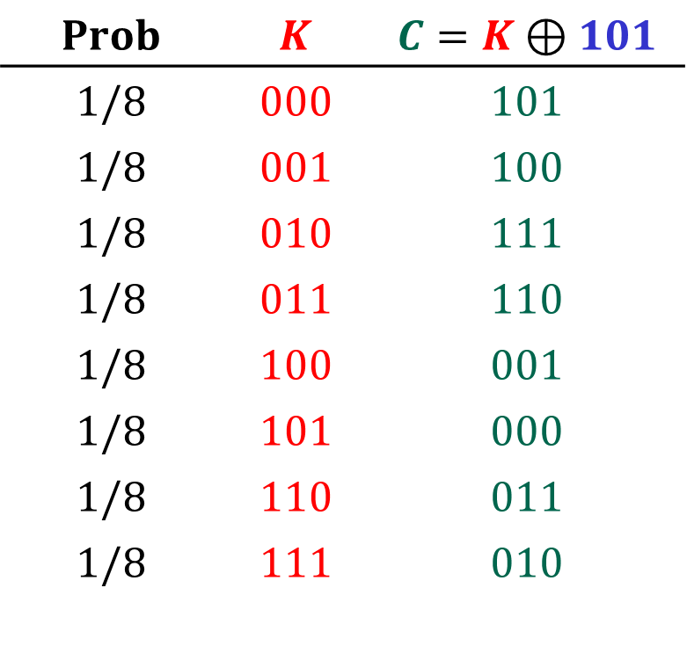
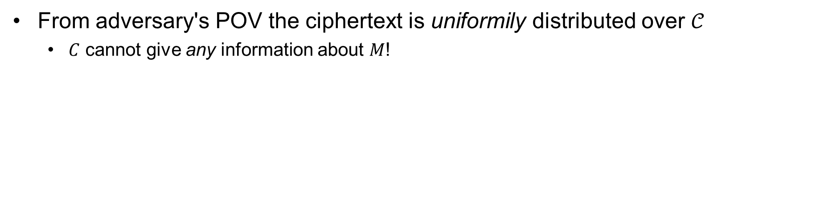
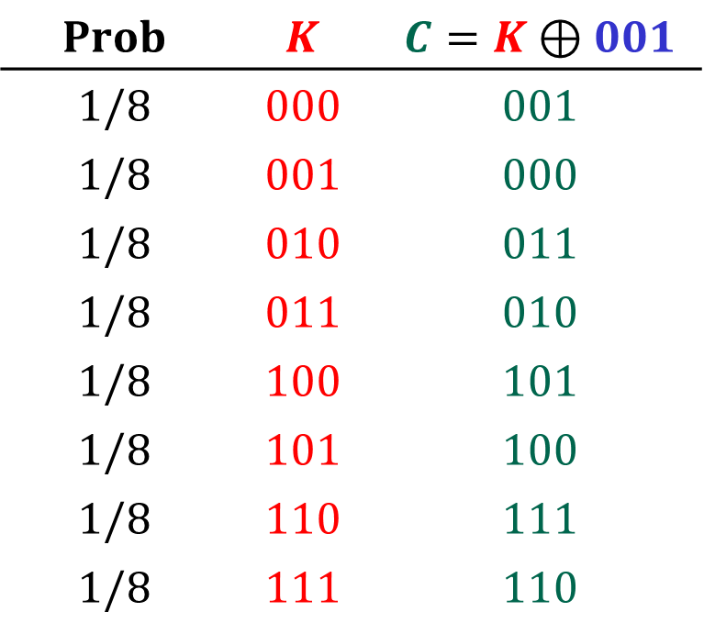
(One-time) perfect secrecy
From adversary's POV the ciphertext is uniformily distributed over $𝒞$
$C$ cannot give any information about $M$!
$$Prob$$ | $$K$$ | $$C=K⊕101$$
$$1/8$$ | $$000$$ | $$101$$
$$1/8$$ | $$001$$ | $$100$$
$$1/8$$ | $$010$$ | $$111$$
$$1/8$$ | $$011$$ | $$110$$
$$1/8$$ | $$100$$ | $$001$$
$$1/8$$ | $$101$$ | $$000$$
$$1/8$$ | $$110$$ | $$011$$
$$1/8$$ | $$111$$ | $$010$$
$$Prob$$ | $$K$$ | $$C=K⊕001$$
$$1/8$$ | $$000$$ | $$001$$
$$1/8$$ | $$001$$ | $$000$$
$$1/8$$ | $$010$$ | $$011$$
$$1/8$$ | $$011$$ | $$010$$
$$1/8$$ | $$100$$ | $$101$$
$$1/8$$ | $$101$$ | $$100$$
$$1/8$$ | $$110$$ | $$111$$
$$1/8$$ | $$111$$ | $$110$$

Slide 36
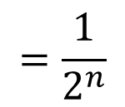

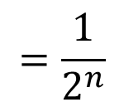
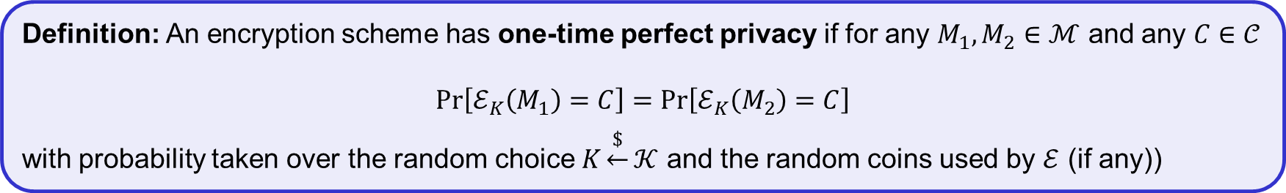




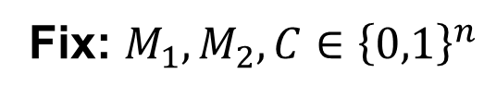

Proof of OTP one-time perfect privacy
Theorem: The OTP encryption scheme has one-time perfect privacy
Definition: An encryption scheme has one-time perfect privacy if for any $M_{1}, M_{2}∈ℳ$ and any $C∈𝒞$
$$Pr\left[ℰ_{K}\left(M_{1}\right)=C\right]=Pr\left[ℰ_{K}\left(M_{2}\right)=C\right]$$
with probability taken over the random choice $K\underset{←}{\$}𝒦$ and the random coins used by $ℰ$ (if any))
Fix: $M_{1}, M_{2}, C∈{\left\{0,1\right\}}^{n}$
Need to show: $\operatorname{Pr}\left[K⊕M_{1}=C\right]=\operatorname{Pr}\left[K⊕M_{2}=C\right]$
$$=\frac{1}{2^{n}}$$
$$\operatorname{Pr}\left[K⊕M_{1}=C\right]$$
$$=Pr\left[K=M_{1}⊕C\right]$$
$$=Pr\left[K=Z_{1}\right]$$
$$=\frac{1}{2^{n}}$$
$$\operatorname{Pr}\left[K⊕M_{2}=C\right]=$$
$$\operatorname{Pr}\left[K=M_{2}⊕C\right]$$
$$=Pr\left[K=Z_{2}\right]$$
QED

Slide 37
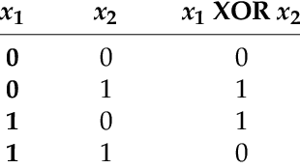
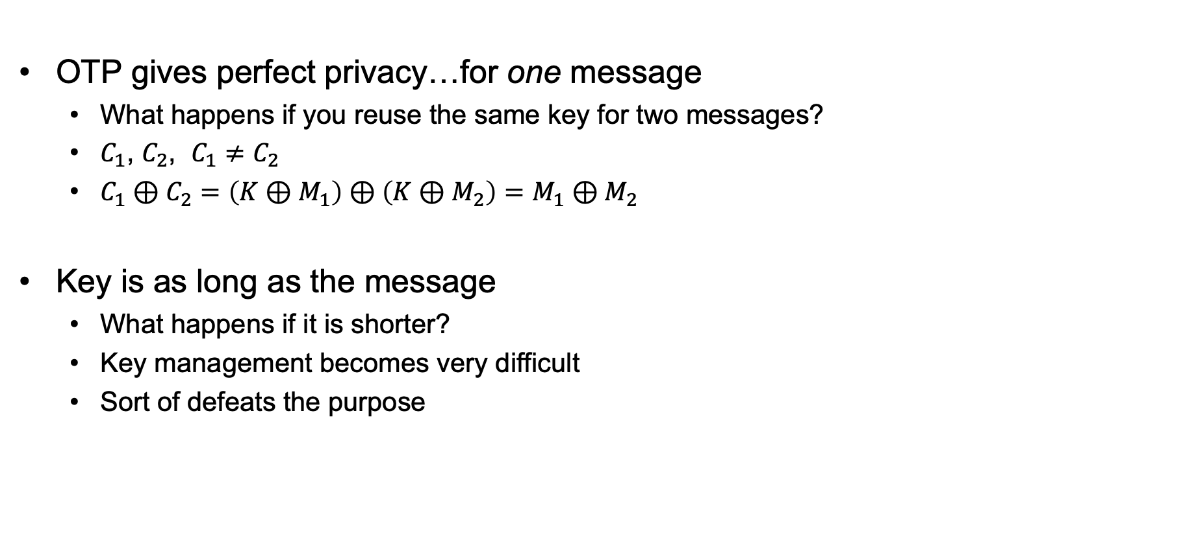
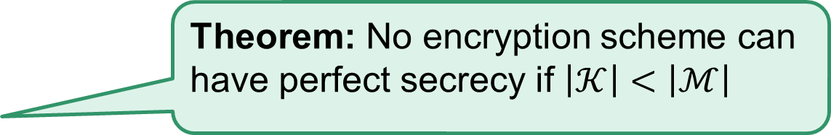
One-time pad – perfect?
OTP gives perfect privacy…for one message
What happens if you reuse the same key for two messages?
$C_{1}$, $C_{2}$, $C_{1}≠C_{2}$
$C_{1}⊕C_{2}=\left(K⊕M_{1}\right)⊕\left(K⊕M_{2}\right)=M_{1}⊕M_{2}$
Key is as long as the message
What happens if it is shorter?
Key management becomes very difficult
Sort of defeats the purpose
Theorem: No encryption scheme can have perfect secrecy if $\left|𝒦\right|<\left|ℳ\right|$

Slide 38
Where do we stand?
We defined the notion of perfect secrecy
We proved that the one-time pad achieves it!
We proved that the one-time pad is optimal!
I.e., we cannot improve the key length
We saw other drawbacks of perfect secrecy
If we want to do better, we need to relax the definition
But in a meaningful way…

Slide 39
Perfect secrecy
Requires that absolutely no information about the plaintext is leaked, even to eavesdroppers with unlimited computational power
Seems unnecessarily strong

Slide 40
Computational secrecy
Would be ok if a scheme leaked information with tiny probability to eavesdroppers with bounded computational resources
I.e., we can relax perfect secrecy by
Allowing security to “fail” with tiny probability
Restricting attention to “efficient” attackers

Slide 41
Tiny probability of failure?
Say security fails with probability 2⁻⁶⁰
Should we be concerned about this?
With probability > 2⁻⁶⁰, the sender and receiver will both be struck by lightning in the next year…
Something that occurs with probability 2⁻⁶⁰/sec is expected to occur once every 100 billion years

Slide 42
Bounded attackers?
Consider brute-force search of key space; assume one key can be tested per clock cycle
Desktop computer ≈ 2⁵⁷ keys/year
Supercomputer ≈ 2⁸⁰ keys/year
Supercomputer since Big Bang ≈ 2¹¹² keys
Restricting attention to attackers who can try 2¹¹² keys is fine!
Modern key space: 2¹²⁸ keys or more…

Slide 43
Outline of course
 | Message privacy | Message integrity / authentication
Symmetric keys | Symmetric encryption | Message authentication codes (MAC)
Asymmetric keys | Asymmetric encryption (a.k.a. public-key encryption) | Digital signatures

Slide 44

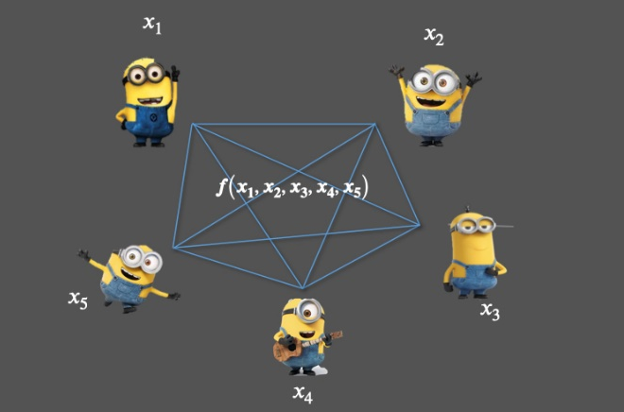
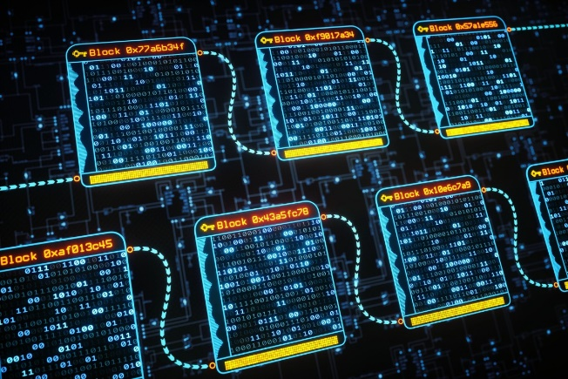
Much more to cryptography
Zero-knowledge proofs
Fully-homomorphic encryption
Multi-party computation
Blockchain
Password?
I know it
Welcome!
$$Enc\left(K, M_{1}+M_{2}\right)=Enc\left(K,M_{1}\right)+Enc\left(K, M_{2}\right)$$

Slide 45
Reminders: Modular arithmetic, Randomized Algorithms
And
What is an adversary?

Slide 46














Modular arithmetic
$$−4$$
$$−3$$
$$−2$$
$$−1$$
$$0$$
$$1$$
$$2$$
$$3$$
$$4$$
$$5$$
$$6$$
$$7$$
$$8$$
$$9$$

Slide 47
Modular arithmetic
$$−4$$
$$−3$$
$$−2$$
$$−1$$
$$0$$
$$1$$
$$2$$
$$3$$
$$4$$
$$5$$
$$6$$
$$7$$
$$8$$
$$9$$

Slide 48




















Modular arithmetic
$$14$$
$$13$$
$$5$$
$$4$$
$$12$$
$$15$$
$$3$$
$$6$$
$$16$$
$$7$$
$$2$$
$$11$$
$$20$$
$$8$$
$$17$$
$$1$$
$$10$$
$$19$$
$$−4$$
$$−3$$
$$−2$$
$$−1$$
$$0$$
$$9$$
$$18$$

Slide 49




Modular arithmetic
$$14$$
$$13$$
$$5$$
$$4$$
$$−4$$
$$12$$
$$15$$
$$3$$
$$6$$
$$−3$$
$$7$$
$$−2$$
$$2$$
$$16$$
$$11$$
$$20$$
$$−1$$
$$8$$
$$17$$
$$1$$
$$10$$
$$19$$
$$0$$
$$9$$
$$18$$

Slide 50










Modular arithmetic
$$14$$
$$13$$
$$5$$
$$4$$
$$1+3=4$$
$$−4$$
$$12$$
$$5+8=13$$
$$≡4 mod⁡9$$
$$15$$
$$3$$
$$6$$
$$−3$$
$$5⋅4=20≡2 mod⁡9$$
$$−2$$
$$2−5=−3≡6 mod⁡9$$
$$16$$
$$7$$
$$2$$
$$11$$
$$20$$
$$2^{10}=1024≡7 mod⁡9$$
$$−1$$
$$8$$
$$17$$
$$1$$
$$10$$
$$158$$
$$=153+r$$
$$≡r\operatorname{mod}{9≡5 mod⁡9}$$
$$19$$
$$0$$
$$9$$
$$r<9$$
$$18$$
$$9→18→27→36→…→153→162$$

Slide 51
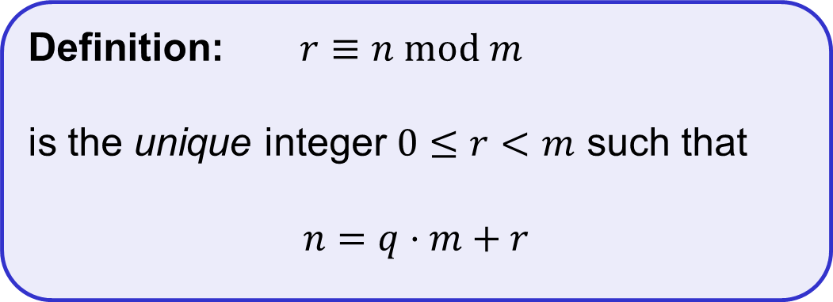
Modular arithmetic
$$14$$
$$13$$
$$5$$
$$4$$
$$1+3=4$$
$$−4$$
$$12$$
$$5+8=13$$
$$≡4 mod⁡9$$
$$15$$
$$3$$
$$6$$
$$−3$$
$$5⋅4=20≡2 mod⁡9$$
$$−2$$
$$2−5=−3≡6 mod⁡9$$
$$16$$
$$7$$
$$2$$
$$11$$
$$20$$
$$2^{10}=1024≡7 mod⁡9$$
$$−1$$
$$8$$
$$17$$
Definition: $r≡n mod m$
is the unique integer $0≤r<m$ such that
$$n=q⋅m+r$$
$$1$$
$$10$$
$$19$$
$$0$$
$$9$$
$$18$$

Slide 52







Randomized algorithms
Inputs
Outputs
Deterministic algorithm: $y←A(x)$
Randomized algorithm:
$y←A(x;r)$ where $r\underset{←}{\$}{\left\{0,1\right\}}^{n}$
$y\underset{←}{\$}A(x)$
$$x$$
$$A(x)$$
$$x$$
$$A(x)$$
$$x′$$
$$A(x)$$

Slide 53
The wiretap channel: “In the beginning”
The Sender
Alice
The Receiver
Bob
Noisy insecure
channel
Plaintext
(P)
Encrypt
Decrypt
Plaintext
(P)
Key (K₁)
Key (K₂)
Message sent is:
C= E_{K1}(P)
Decrypted as:
P=D_{K2}(C)
P is called plaintext.
C is called ciphertext.
Eavesdropper
Symmetric Key: K₁=K₂

Slide 54
Cryptography and adversaries
Cryptography is computing in the presence of an adversary.
What do you want to protect?
Against who?
Under what circumstances?
An adversary is characterized by:
Talent
Access to information
Probable plaintext attacks.
Known plaintext/ciphertext attacks.
Chosen plaintext attacks.
Adaptive interactive chosen plaintext attacks (oracle model).
Computational resources

Slide 55
Computational strength of adversary
Infinite - Perfect Security
Information Theoretic
Doesn’t depend on computing resources or time available
Polynomial
Asymptotic measure of computing power
Indicative but not dispositive
Realistic
The actual computing resources under known or suspected attacks.
This is us.

Slide 56
Cipher Requirements
Before
Universally available (simple, light instrumentation) – interoperability.
Compact, rugged: easy for people (soldiers) to use.
Adversary has access to some corresponding plain and ciphertext
Now
Adversary has access to unlimited ciphertext and lots of chosen text.
Implementation in digital devices (power/speed) paramount.
Easy for computers to use.
Resistant to ridiculous amount of computing power.
Kerckhoff’s Principle: Security in key only: We assume that the attacker knows the complete details of the cryptographic algorithm and implementation

